Slide 1

Comparative Evaluation of Segmentation and Object Detection Models for Pallet Recognition
Aksheya Kannan Subramanian
Michael Acquah
Faten Alshohatee
CIS 583 – Deep Learning
Each slide in this presentation has an accompanying audio recording. Feel free to play them manually or view the presentation in SlideShow mode for the full experience.

Slide 2
Motivation
Autonomous warehouses require reliable perception for safe robot navigation
Two key tasks: ground segmentation and pallet detection
Traditional CV struggles with lighting, shadows, reflections
Deep learning provides stronger robustness for real industrial environments
Goal: compare segmentation and detection models for warehouse deployment

Slide 3
Research Questions
How do U-Net and DeepLabV3+ compare for warehouse ground segmentation?
How do YOLOv8 and EfficientDet-D0 differ in pallet detection performance?
What are the key trade-offs in accuracy, latency/FPS, confidence calibration, and model size for real-time deployment?

Slide 4
Dataset: EuroPalletSeg
Real indoor warehouse scenes with pallets, shelving, and concrete flooring
Challenging visual conditions: shadows, reflections, partial occlusions
Ground segmentation masks
YOLO-format pallet bounding boxes
Separate train/validation splits with 585 validation images for each task

Slide 5
Dataset Creation
How the Ground Masks Were Created
Generated using Meta AI’s Segment Anything Model (SAM)
Manually drew bounding boxes to guide SAM
Inspected and verified segmentation previews for accuracy
Refined or created additional masks for ~2000 images using LabelMe
Final Output
A golden-quality, high-fidelity ground segmentation dataset
Fully aligned with the original images and optimized for warehouse perception tasks

Slide 6
Preprocessing
Segmentation Pipeline
Resize images to 256×256
Apply model-specific normalization
U-Net → scale to [0,1]
DeepLabV3+ → ImageNet mean/std
Resize masks with nearest-neighbor interpolation
Apply binary thresholding (>127) to clean the mask
Detection Pipeline
Resize images to 512×512
Convert YOLO labels from normalized → pixel coordinates
Use absolute coordinates for IoU + evaluation consistency
EfficientDet Postprocessing
EfficientDet-D0 outputs many raw predictions
Only the top 5 highest-confidence boxes per image were kept for comparison + visualization

Slide 7
Models Evaluated
Segmentation Models
U-Net — 209 MB
Encoder–decoder with skip connections; high spatial precision
DeepLabV3+ (MobileNetV3) — 18 MB
Atrous Spatial Pyramid Pooling; lightweight + efficient
Detection Models
YOLOv8 — 42 MB
One-stage detector with fast, confident predictions
EfficientDet-D0 — 15 MB
Compact detector using EfficientNet + BiFPN

Slide 8
U-Net Overview
Architecture
Classical encoder–decoder structure
Uses skip connections to recover spatial detail lost during downsampling
Strengths
Produces sharp, accurate segmentation masks
Well-suited for tasks requiring precise boundary reconstruction
Large model size (209 MB) → less efficient for embedded or real-time deployment

Slide 9
DeepLabV3+ Overview
Architecture
Atrous Spatial Pyramid Pooling (ASPP) for multi-scale context
MobileNetV3 encoder for efficient feature extraction
Decoder refines segmentation boundaries
Strengths
Lightweight (18 MB) and fast
Captures both local detail and global context
Well-suited for resource-constrained or real-time robotics

Slide 10
YOLOv8 Overview
Architecture
One-stage detector with a modern C2f backbone
Decoupled detection head improves box + class predictions
Strengths
Fast inference and low latency on CPU
High confidence scores and stable predictions
Robust pallet detection, even under reflections and occlusions

Slide 11
EfficientDet-D0 Overview
Architecture
EfficientNet-B0 backbone for compact, high-quality feature extraction
BiFPN (Bidirectional Feature Pyramid Network) for efficient multi-scale fusion
Designed with compound scaling for balanced depth, width, and resolution
Strengths
Very small model size (~15 MB)
Highly efficient and lightweight, ideal for low-power or embedded devices
Optimized for speed while maintaining reasonable accuracy on general object detection tasks

Slide 12
Evaluation Metrics
Segmentation Metrics
IoU (Intersection over Union) – overlap quality
Dice Coefficient – foreground accuracy
Pixel Accuracy – overall correctness
Precision / Recall – false positives vs. false negatives
Detection Metrics
mAP@0.5 – bounding box quality
FPS – inference speed
Latency – per-image processing time
Confidence Scores – model certainty in detections

Slide 13
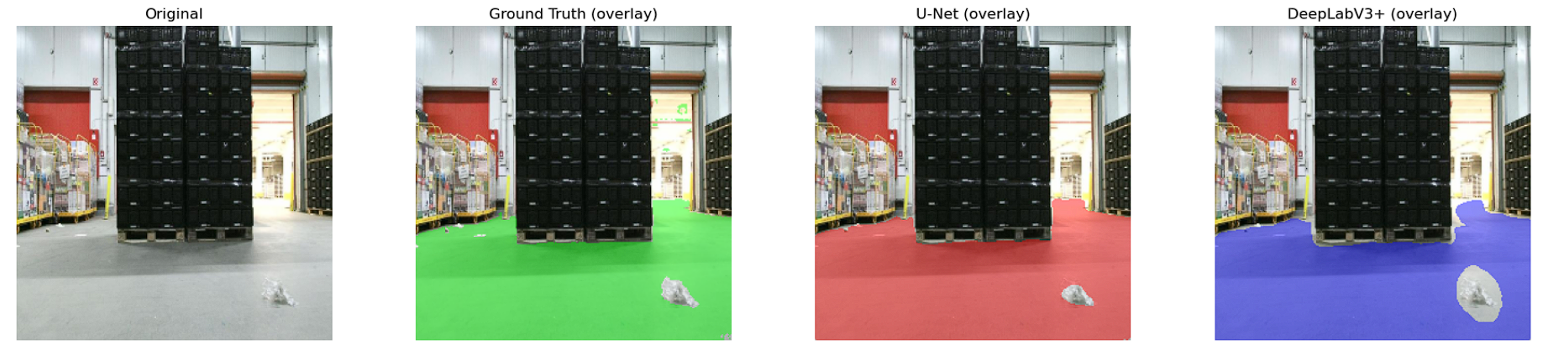
Segmentation Results
Model | IoU | Dice
U-Net | 0.951 | 0.973
DeepLabV3+ | 0.921 | 0.973

Slide 14
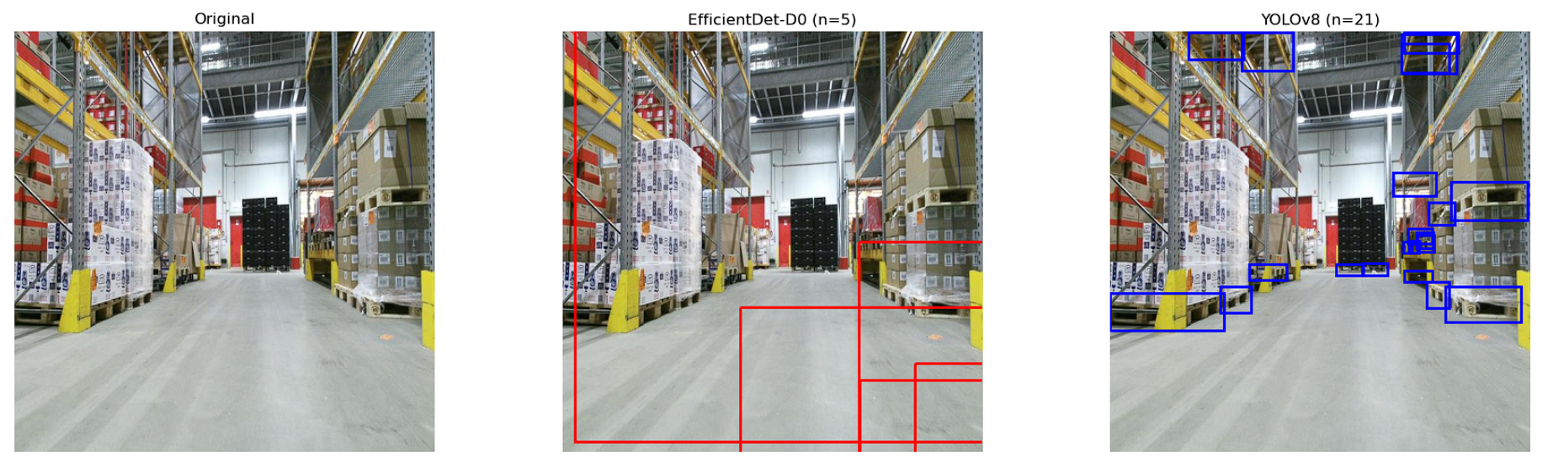
Detection Results
Model | mAP@0.5 | Latency (ms) | FPS
EfficientDet-D0 | 0.000 | 158.55 | 6.30
YOLOv8 | 0.0014 | 95.44 | 10.47

Slide 15
Qualitative Results
U-Net: produces sharper, more detailed ground masks
DeepLabV3+: smooth and coherent masks, slightly less precise at boundaries
YOLOv8: consistent and reliable pallet bounding boxes
EfficientDet-D0: weak detections with very low confidence, often missing pallets

Slide 16
Limitations
📌 Experimental Constraints
CPU-only evaluation, limiting achievable speed
Restricted hyperparameter tuning due to compute constraints
📌 Model-Specific Challenges
EfficientDet-D0 required confidence calibration, which was not fully explored
📌 Scope Limitations
No multi-task or joint segmentation–detection model evaluated

Slide 17
Future Work
Hyperparameter tuning and calibration for EfficientDet-D0
Explore next-generation detectors such as YOLOv9 or transformer-based models
Develop a multi-task model combining segmentation + detection in one network
Test models on edge hardware (e.g., Jetson, Raspberry Pi, industrial robotics hardware)
Evaluate performance after optimization (quantization, pruning)

Slide 18
Conclusion
U-Net produced the most accurate segmentation, while DeepLabV3+ was nearly as effective but much more efficient.
YOLOv8 was the most practical and reliable for pallet detection, while EfficientDet-D0 needed more tuning despite being lightweight.
Our findings suggest using U-Net or DeepLabV3+ based on compute resources and deploying YOLOv8 for reliable pallet detection.

Slide 19
THANK YOU!

